Slide 1
Chapter 6. Fama-MacBeth Regression
Financial Econometrics
Department of financial engineering
Zhongnan university of economics and law
Xu Yonghao

Slide 2
oUTLINE
Introduction
Portfolio Method
Fama-MacBeth Regression
Case of Asset Pricing
Proposal Writing

Slide 3
1 Introduction: asset pricing
Debt
Debt is an obligation that requires one party, the debtor, to pay money or other agreed-upon value to another party, the creditor. Debt is a deferred payment, or series of payments, which differentiates it from an immediate purchase.
Stock
Stock is all of the shares into which ownership of a corporation is divided. A single share of the stock represents fractional ownership of the corporation in proportion to the total number of shares.
Derivative
In finance, a derivative is a contract that derives its value from the performance of an underlying entity. This underlying entity can be an asset, index, or interest rate, and is often simply called the "underlying".

Slide 4

1.1 Introduction: stock
Eugene Francis Fama; (born February 14, 1939) is an American economist, best known for his empirical work on portfolio theory, asset pricing, and the efficient-market hypothesis.
He is currently Robert R. McCormick Distinguished Service Professor of Finance at the University of Chicago Booth School of Business. In 2013, he shared the Nobel Memorial Prize in Economic Sciences jointly with Robert J. Shiller and Lars Peter Hansen
EMH, FF3 and FF5 factor model.

Slide 5

1.1 Introduction: stock
Robert James Shiller (born March 29, 1946) is an American economist (Nobel Laureate in 2013), academic, and best-selling author. As of 2019, he serves as a Sterling Professor of Economics at Yale University.
Eugene Fama, Lars Peter Hansen and Shiller jointly received the 2013 Nobel Memorial Prize in Economic Sciences, "for their empirical analysis of asset prices
He has written on economic topics that range from behavioral finance to real estate to risk management, and has been co-organizer of NBER workshops on behavioral finance with Richard Thaler since 1991.

Slide 6

1.1 Introduction: stock
Lars Peter Hansen (born 26 October 1952 in Urbana, Illinois) is an American economist. He is the David Rockefeller Distinguished Service Professor of economics at the University of Chicago and a 2013 recipient of the Nobel Memorial Prize in Economics.
Hansen is best known as the developer of the econometric technique generalized method of moments (GMM) and has written and co-authored papers applying GMM to analyze economic models in numerous fields including labor economics, international finance, finance and macroeconomics.

Slide 7
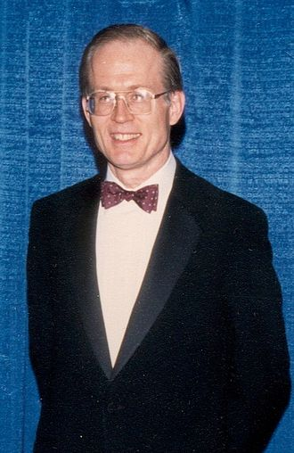


1.2 Introduction: Black–Scholes
Fischer Black
Myron Scholes
Robert C. Merton
In 1997 Merton Together with Myron Scholes were awarded the Nobel Memorial Prize in Economic Sciences for a method to determine the value of derivatives.

Slide 8
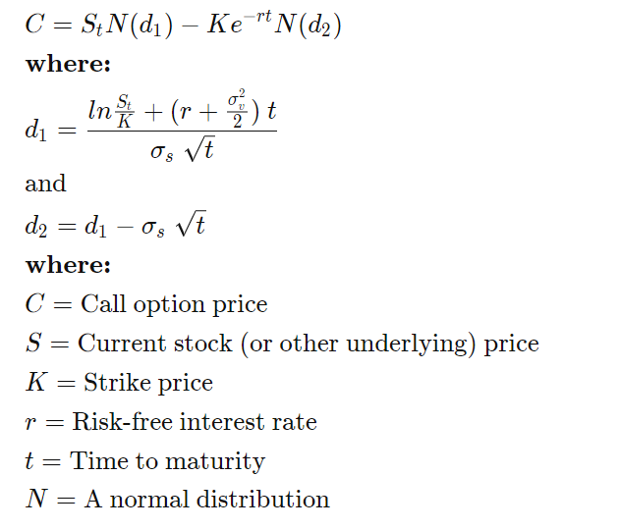
1.2 Introduction: Black–Scholes

Slide 9
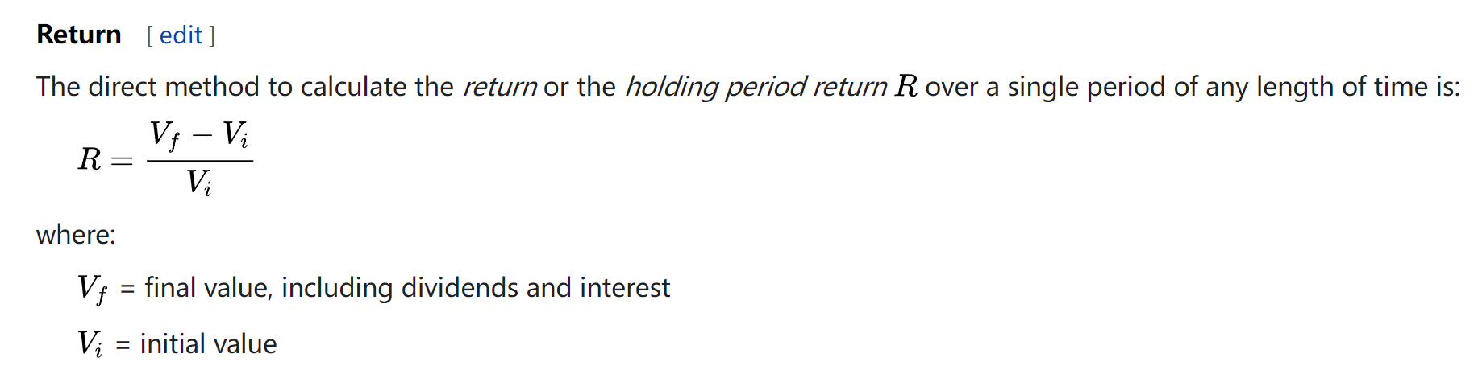
1.3 Introduction: return of stock
Raw Return: Net return of stocks.
The return, or the holding period return, can be calculated over a single period. The single period may last any length of time.

Slide 10
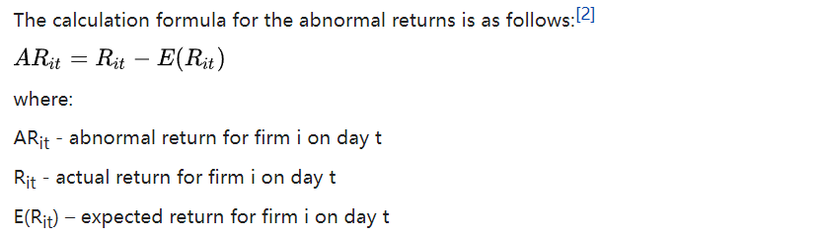
1.3 Introduction: return of stock
Abnormal Return: An abnormal return is one that deviates from an investment's expected return.
Cumulative abnormal return, or CAR, is the sum of all abnormal returns.

Slide 11
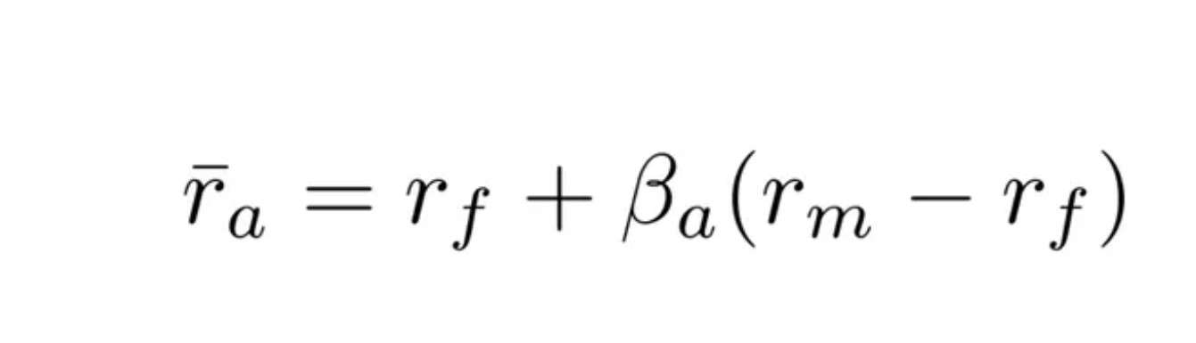
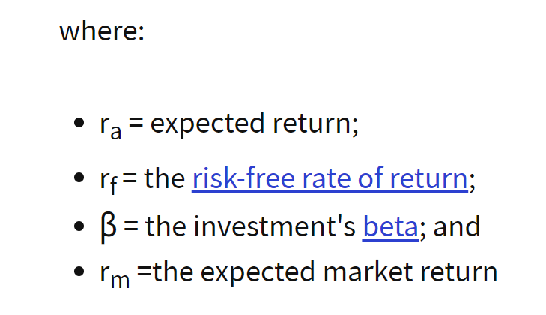
1.3 Introduction: return of stock
Expected Return: The expected return is usually based on historical data and expected distribution of stock return. i.e., CAPM, FF3 et al.

Slide 12
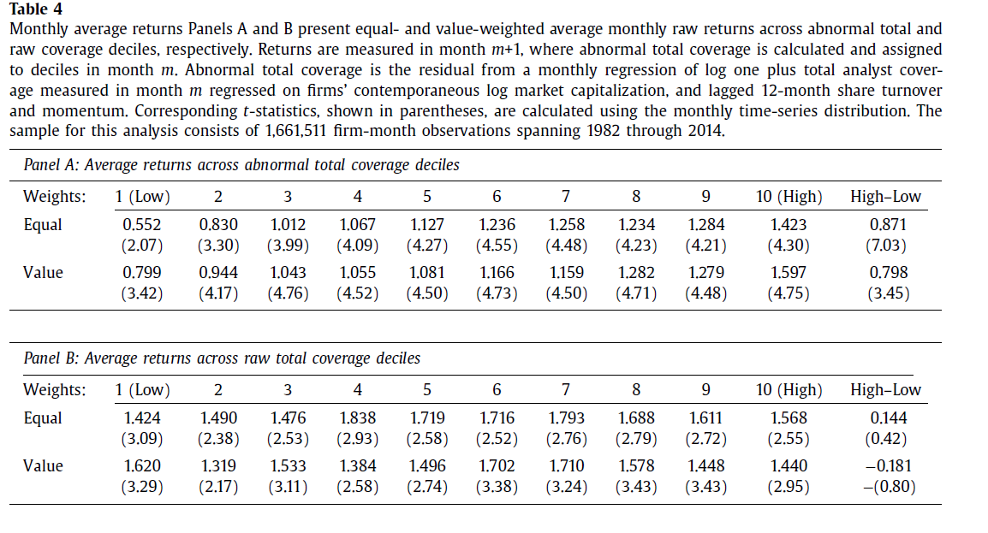
2 Portfolio Method
Long-short portfolio method is an investing strategy that takes long positions in stocks that are expected to appreciate and short positions in stocks that are expected to decline. A long-short equity strategy seeks to minimize market exposure while profiting from stock gains in the long positions, along with price declines in the short positions.
Lee and So (2017)

Slide 13
2 Portfolio Method
Fama and French (1992, 1993, 1996) proposed a three factor model. They found that, when using this model to adjust risks, almost all known trading strategies have no excess return.
For example, reversal strategy: buy (sell) the stocks with the lowest (highest) returns in the past 3-5 years, and hold them for 3 to 6 months.
What cannot be explained is the momentum strategy: buy (sell) the stocks with the highest (lowest) returns in the past 6-12 months, and hold them for 6-12 months.
The FF three factor model (and the four factor model includes the momentum factors; and Fama and French (2015) proposed the five factor model) is widely used in the field of empirical asset pricing to test the efficiency of the market and whether a trading strategy can earn excess returns (Alpha).

Slide 14
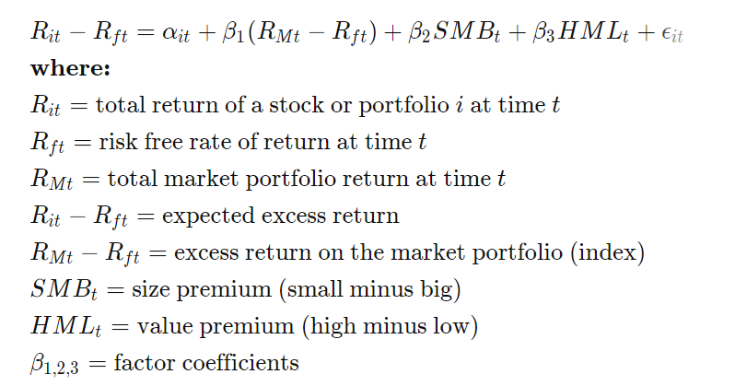
2.1Fama-French 3 factor model

Slide 15
2.2 Portfolio Method
Portfolio method and time series tests
Fama and French（1993,1996）
Step 1：construct the dependent variable: raw return
Step 2：construct the factors of Rm-Rf, SMB and HML
Step 3：construct the single portfolio and calculate the abnormal return
Step 4：construct the long short portfolio and test whether such portfolio brings significant excess return (alpha).

Slide 16
2.2 Portfolio Method
Step 1：construct the dependent variable: return series
Usually, monthly time series data (based on panel data)
For example, testing a trading strategy (reversal), we need a time series data of return constructed based on the reversal strategy.

Slide 17
2.2 Portfolio Method
Step 1： the dependent variable: return series
Sorted by single variable X：
Sort the stocks in time t (i.e., monthly), according the Xt-1, split the stocks into 10 groups.
i.e., firm value in time t, 10 groups（S1， S2， …， S0）
Hold the 10 portfolios of stocks from time t to time t+1.
Calculate the mean return (arithmetic or value weighted) of the 10 portfolios.
If you got data of 10 years, then you get 120 monthly return in each portfolios.

Slide 18
2.2 Portfolio Method
Step 1： the dependent variable: return series
Fama and French（1993）, Sorted by multiple (i.e., double) variables X1 X2：(double sorting)
In this case, firm value and BM, into 25 groups.
Sequential grouping (顺序分组)
sorted by variable X1 (size) in time t-1, into 5 groups （S1， S2， …， S5）
Within each group, sorted by variable X2(BM) in time t-1, into 5 groups (S1B1,S1B2, …S1B5, …S5B4, S5B5)
Cross-grouping (交叉分组)
sorted by variable X1 (size) in time t-1, into 5 groups （S1， S2， …， S5）
sorted by variable X2 (BM) in time t-1, into 5 groups （B1， B2， …， B5）
Naturally, we got 25 groups (S1B1,S1B2, …S1B5, …S5B4, S5B5)
Calculate the mean return (arithmetic or value weighted) of the 10 portfolios.
If you got data of 10 years, then you get 120 monthly return in each portfolios.

Slide 19
2.2 Portfolio Method
Step 2：Construct factors rm-rf、SMB and HML
Here, like the CAPM model, the DV and IDV are in the same time t.
CSMAR, WRDS, the authors, provide factors in their database.
Rm, market return, empirically, index return.
Rf risk free rate, empirically, monthly fixed deposit interest rate.
SMB, size factor, the return of portfolio S1 minus the return of portfolio S5
HML, growth factor , the return of portfolio B1 minus the return of portfolio B5

Slide 20
2.2 Portfolio Method
Step3：construct the single portfolio and calculate the abnormal return
i.e., you want to calculate the abnormal return of portfolios constructed based on unexpected analyst forecast (variable UAF)
Like the grouping method in 2.2, we can construct return time series data of 10 portfolios based on UAF(UAF1,UAF2, ***,UAF10)
Step4： construct the long short portfolio and test whether such portfolio brings significant excess return (alpha).

Slide 21
3 Fama-MacBeth Regression
Fama-MacBeth Regression
Fama and French (1992) cross-section regression / Fama-Macbeth Regression
Step 1： construct the dependent variable: return
Step 2： construct the independent variable: Rm-Rf, Size and BM
Step 3： regress y on x in every single time period (i.e., monthly)
Step 4： adding all the regressions and test the coefficients accordingly

Slide 22


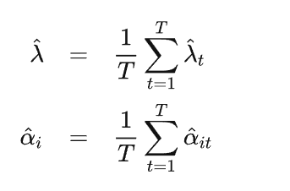
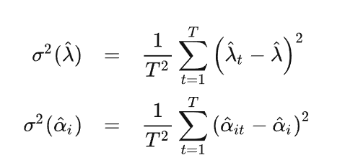
3 example:Single factor
Step1, time-series regression for each stock i, from time 1 to T.
Step2, cross-sectional regression for each time t, from stock 1 to N.
Step3, add (calculate the mean) all the results together and test its significance.

Slide 23
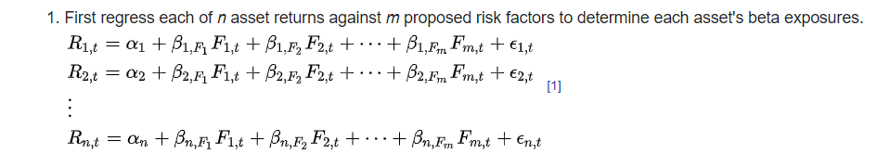
3 Fama-MacBeth Regression

Slide 24
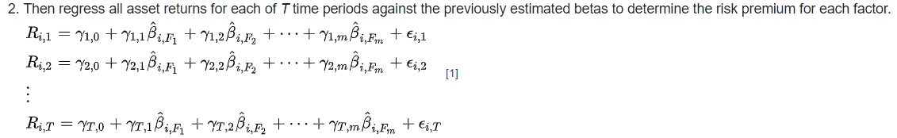
3 Fama-MacBeth Regression

Slide 25
3 Fama-MacBeth Regression: S.D.
Unbiased

Slide 26
3 Fama-MacBeth Regression: S.D.

Slide 27
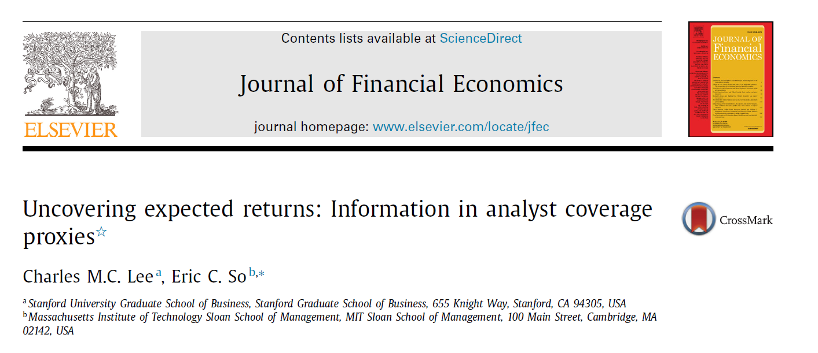
4 Case of Asset Pricing

Slide 28
4.1 Portfolio return

Slide 29
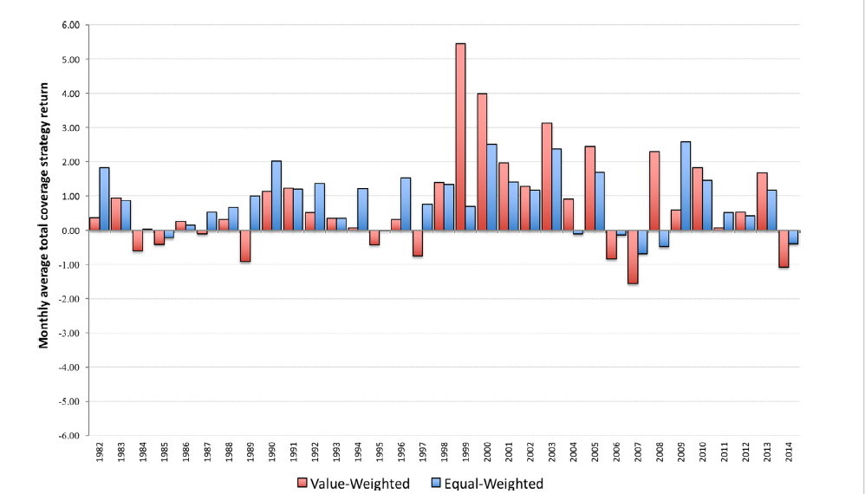
4.1 Portfolio return

Slide 30
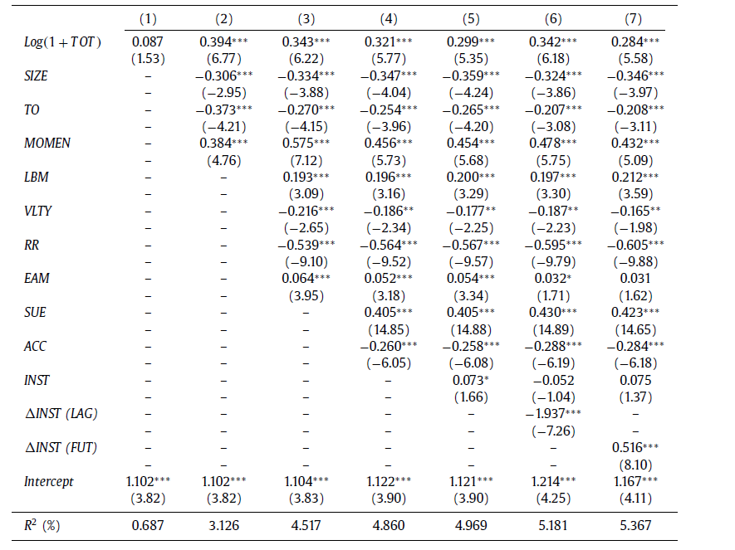
4.2 Fama-MacBeth Regression

Slide 31
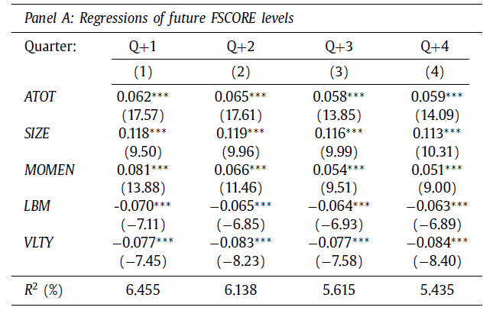
4.3 regression analysis: fundmental

Slide 32
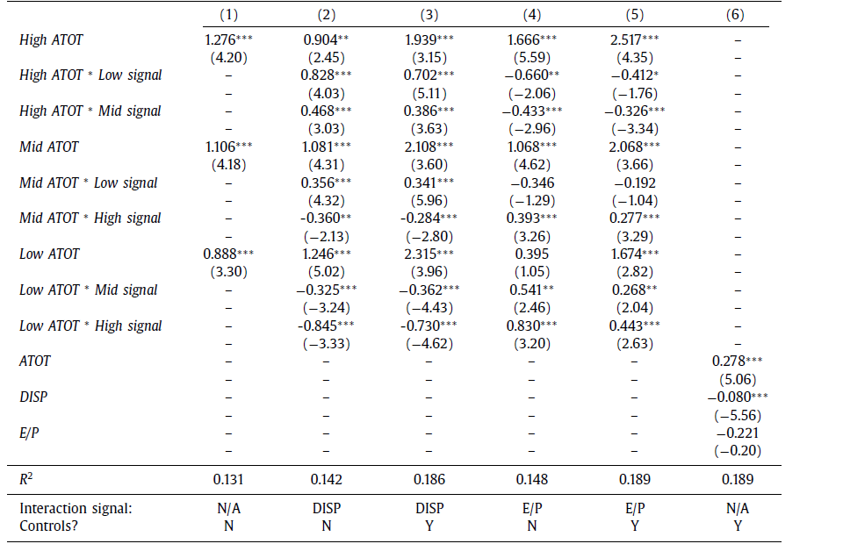
4.4 mechanism
The interaction terms show that returns are highest among firms with high abnormal coverage and low forecast dispersion (i.e., low disagreement), whereas returns are lowest among firms with low abnormal coverage and high forecast dispersion (i.e., high disagreement).

Slide 33
5 Proposal Writing
new idea
new method
new data
1 replication with institutional difference
2 hot/new topic
3 cross-over studies
Level

Slide 34
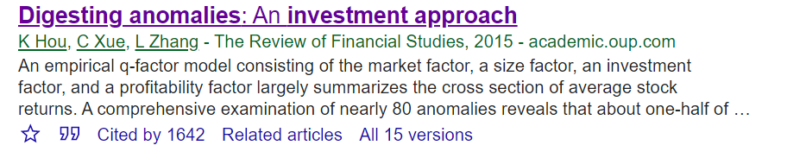
5.1.1 idea: why factors should be added?

Slide 35
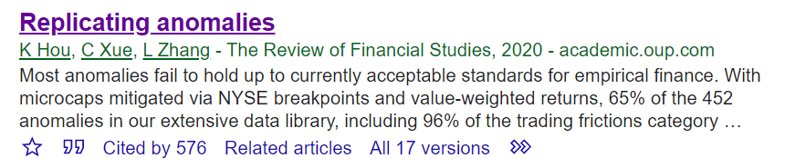
5.1.2 Method: replicate all anomalies

Slide 36
5.1.3 data+method

Slide 37
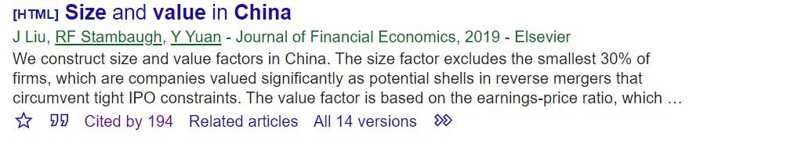


5.2.1 replication
Global research
Study in China

Slide 38

5.2.2 hot/new topic

Slide 39

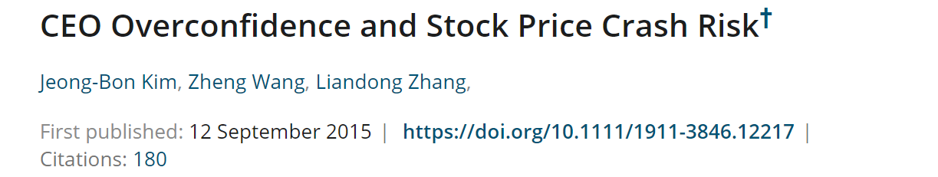
5.2.3 cross-over studies

Slide 40
5.3 proposal writing details
Why?
Contribution?
Academic Importance
Realistic Importance
Never Studied
Endogeneity
Different Results
How?
Data
Empirical Design

